Slide 1
QA TEST MANAGEMENT PLATFORM
overview
Jason Wang SW QA
Aug 2024

Slide 2
Agenda
Platform Overview
Case build & run
Suite build & run
Project build & run
Run Control and Results check
Q&A

Slide 3

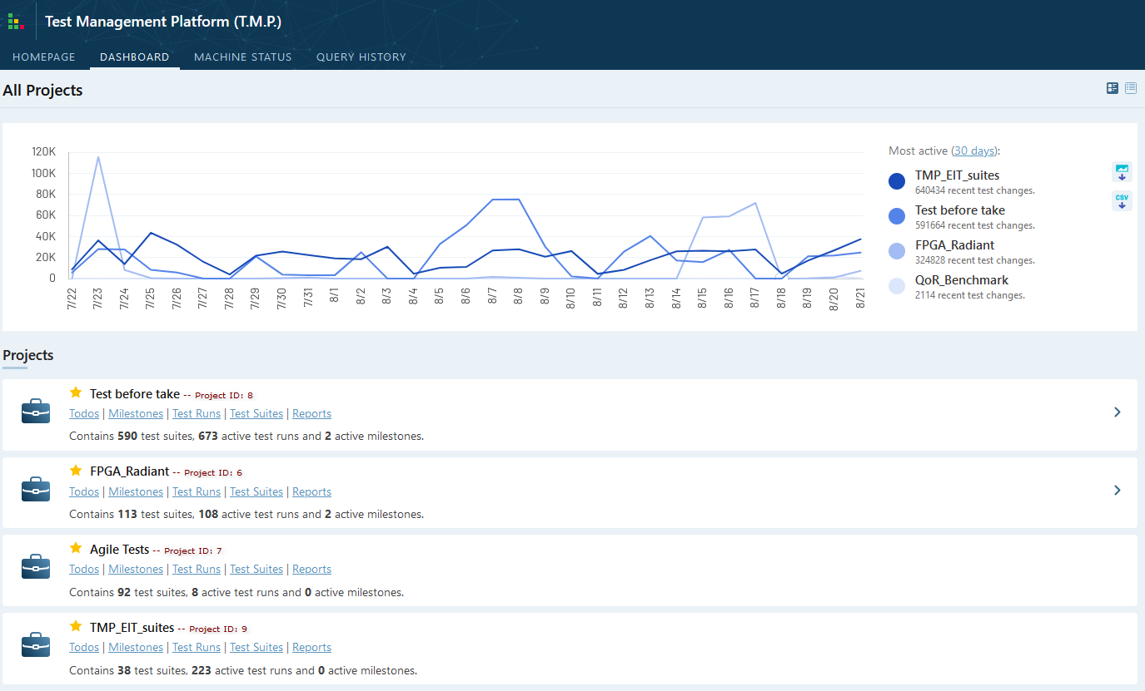
Overview -- TMP Webpages
Dashboard
http://lsh-tmp/testrail/index.php?/dashboard
Background machines
Project perspective
Overview status
*Please apply account first from TMP admin (Shawn Yan <Shawn.Yan@latticesemi.com>)
Notes:
TestRail is a web-based test case management tool. It is used by testers, developers and team leads to manage, track and organize software testing efforts. TestRail allows team members to enter test cases, organize test suites, execute test runs and track their results, all from a modern and easy to use web interface.
To use TMP, please apply account first from TMP admin (Shawn Yan <Shawn.Yan@latticesemi.com>)

Slide 4
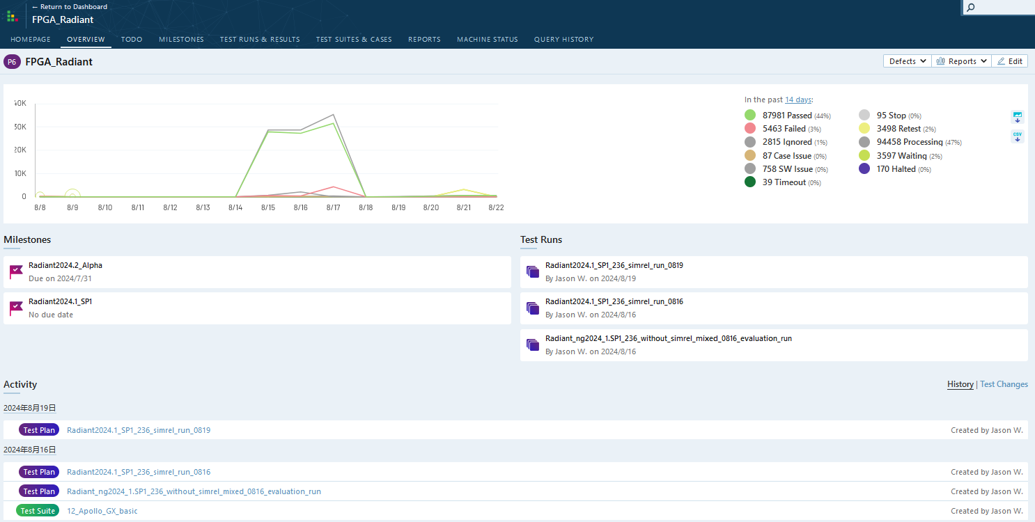
Overview -- TMP Webpages
Project Page
Project status
More project tabs
Milestones
Test Runs
Recent activity
Notes:
OVERVIEW: show current project related status
TODO:
MILESTONES: organized by test cycle in different milestones
TEST RUNS & RESULTS:
TEST SUITES & CASES:
REPORTS: not ready
MACHINES: ALL background machines

Slide 5
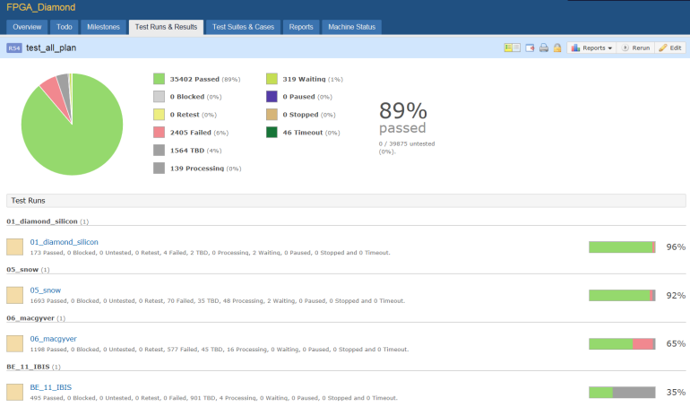
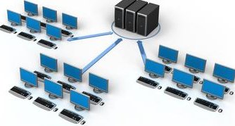
Overview -- TMP Architecture
Overview
Frontend Webpages
TMP transfer 6 elements instead of real design:
[CaseInfo]: repository, priority, timeout…
[Environment]: env setting before task launch
[LaunchCommand]: run command for a design
[Software]: software requirements for task run
[System]: System requirements for task run
[Machine]: Machine requirements for task run
Job Servers
Case
Repository
Backend Clients
Results
Storage

Slide 6
Overview -- TMP Tool-Chain User Interface
Test Case
Test Suite
Test Project
User
objective
Core Script
TMP Client
TMP Server
Platform
support

Slide 7
User Interface -- Case Build
Case structure
A standard case includes: 3 folders and 4 related files as following:
case1/
/--testdata/ -- (Optional) Test data, like Squish case suite data, object files
/--testdesign/ -- Real test design
/--models/ -- All IP related files
/--others/ -- (Optional) Design scripts and other misc. files
/--par/ -- Project directory contains project, constraint and constraint files
/--sim/ -- Testbench files
/--src/ -- Design RTL source files
/--testmethod/ -- (Optional) Test scripts or method, like Squish case public method and scripts
/--bqs.conf -- Result check file (Give PASS/FAIL result)
/--bqs.info -- Script run boot file (flow, simulation and etc.)
/--run_info.ini -- (Optional) Detail information to run this case: Environment,LaunchCMD…
/--readme.txt -- Case description
Note:
testdata, testmethod, run_info.ini, readme.txt are optional for script run but it is recommended for a case
Demo: <Client_install_path>/doc/TMP_example/standard_case/case1

Slide 8
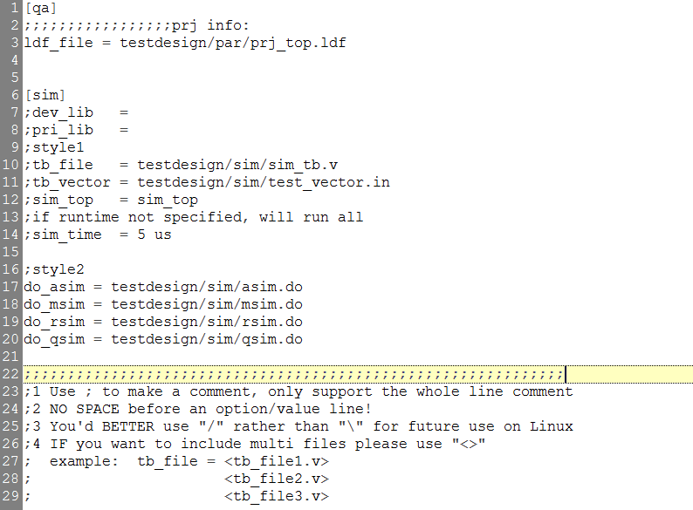
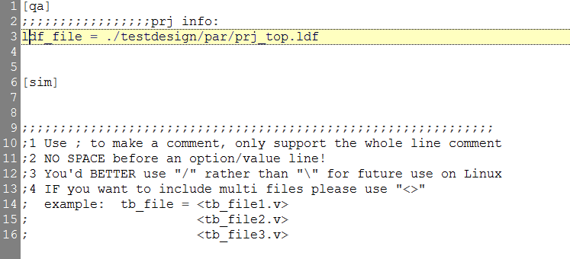
User Interface -- Case Build
*.info Details
*. info file is an ini format file. In general, it’s necessary for a test case to provide Diamond/Radiant project location or source location and simulation related info(based on run)
Project location
Semi-column as comment
Note:
If there is no *.info file, corescript will search *.ldf or *.rdf under case folder or /par folder to run TCL flow.
For all available options, refer to: <Client_install_path>/doc/TMP_doc/User Standard Case Build Usage.docx

Slide 9
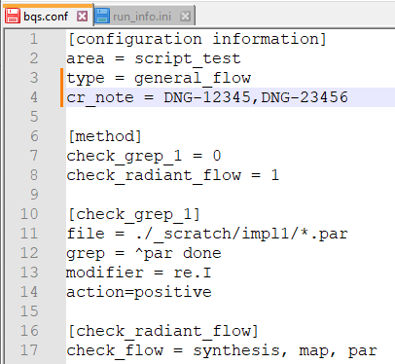
User Interface -- Case Build
*.conf Details
*.conf file used to run auto check and generate final PASS/FAIL result by script.
cr_note: test case related CR. When script run this case and fails:
Return ‘Failed’, if all noted CR are closed
Return ‘SW issue’, if any noted CR still open
Method: check method section, tell check script which one is valid:
0: Check method is invalid, skip it
1: Check method is valid, run following detail check section
Check method: Script check test case run results according this method details and give results.
Note:
For all available Methods, refer to: <Client_install_path>/doc/TMP_doc/User Platform Core script Check Script usage.docx

Slide 10
Overview -- TMP Tool-Chain User Interface
Test Case
Test Suite
Test Project
User
objective
Core Script
TMP Client
TMP Server
Platform
support

Slide 11
User Interface -- Case Run with CoreScript
CoreScript is a bunch of Python script files used to run Radiant/Diamond implementation, simulation flow in console mode.
Supported flow/run:
Design implementation flow, i.e. run Map, PAR flow
Design simulation flow, i.e. run RTL, Post-syn, Post-PAR simulation
Design TCL flow, run Radiant TCL commands
Design command flow, run Radiant engine commands directly, i.e. map, par…
Design GUI flow(work with Squish and Squish Perl scripts)
QoR flow(Pushbutton, Sweeping, Iteration and Repeat)
Export CoreScript:
Install Client
Launch Client
Client will export latest CoreScript(DEV) in work_space
Note: See ‘Appendix 1’ for Client installation

Slide 12
User Interface -- Case Run with CoreScript
Typical Command
python DEV/bin/run_radiant.py [project options] [impl options] [sim options] –design=xxx
[project options]:
--devkit <DEVKIT> --update project device
--synthesis {synplify,lse} --update project synthesis tool
--run-ipgen --update project IP files
[impl options]:
--run-synthesis --run design synthesis flow
--run-par-trace --run design PAR and Trace flow
--run-export-bitstream --run design bitgen flow
[sim options]:
--sim-rtl --run RTL simulation flow
--sim-par-vlg --run Post-PAR simulation flow
--run-simrel --run simrel flow
Note:
Please run ‘python DEV/bin/run_radiant.py --help’ for complete options
Please set environment ‘EXTERNAL_RADIANT_PATH’ before run!!!
For details, refer to: <Client_install_path>/doc/TMP_doc/User Platform Core script usage.docx

Slide 13
User Interface -- Case Run with CoreScript
Run Demo
Environment Setting:
Win: set EXTERNAL_RADIANT_PATH= D:\lscc\radiant\2024.2.121
Lin: setenv EXTERNAL_RADIANT_PATH /lsh/sw/qa/qadata/radiant/lin/ng2024_2.155
Run Commands:
Case1: A design need to update IP first then run design to PAR and check PAR result
python DEV/bin/run_radiant.py --run-ipgen --run-par --check-conf=bqs.conf --design=<design name>
--check-conf: use ‘bqs.conf’ file to check design, without this option script will find a file end with ‘.conf’ and check run results by default
Case2: A design need to update device first then run design to Post-PAR simulation and check simulation result
python DEV/bin/run_radiant.py --devkit=LFCPNX-100-7LFG672I [--run-par] –sim-par-vlg --design=<design name>
--run-par: optional, ‘--sim-par-vlg’ will run PAR flow automatically
--check-conf: didn’t present, script will find a file end with ‘.conf’ and check sim results by default
Case3: A design need to update strategy, run design PAR trace and Post-PAR simulation then check flow and simulation result
python DEV/bin/run_radiant.py --set-strategy="syn_res_sharing=False” --run-par-trace –sim-par-vlg --check-conf=impl.conf,sim.conf --design=<design name>
--set-strategy: Try on Radiant TCL console first to get real TCL strategy setting and put it here
--check-conf: Support multiple config files

Slide 14
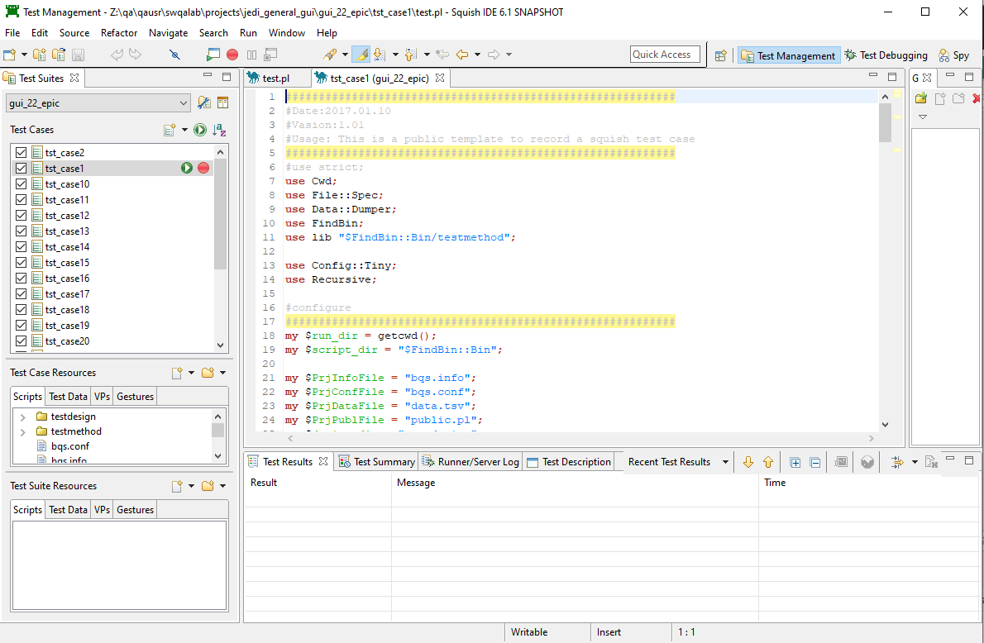
User Interface -- Case Run with Squish
GUI Case
Install Squish GUI
Open Test Suite
Setup run environment
Launch squish test by GUI
Note: Squish owner will give you details for this section, Training Squish usage.pptx

Slide 15
User Interface -- Case Run with Client
‘run_info.ini’ is a must file when you run test case(s) with Client. This file contains all 6 elements Client need to know before run.
A run_info.ini file has following sections:
[Base]
update_date=2024-08-18
author=xxx
[General]
nouse=
design_name=xxx
testlevel=1
testscenarios=
description=xxx
…
*:For user
[CaseInfo]
priority=
timeout=
[Environment]
A=1
B=2
[LaunchCommand]
cmd=python DEV/bin/run_radiant.py --run-par
override=
[Software]
radiant=ng2024.2
[System]
os_type=
[Machine]
terminal=
group=regression_group
Note:
When Client launch a local test case, [System] and [Machine] requirements will be ignored
Client will check ‘ng2024.2’ available first, if not exists case will be rejected
Info file demo: <Client_install_path>/doc/TMP_doc/TMP_example/standard_case/case1/run_info.ini

Slide 16
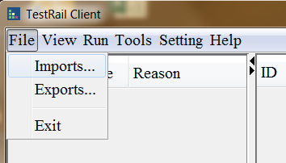
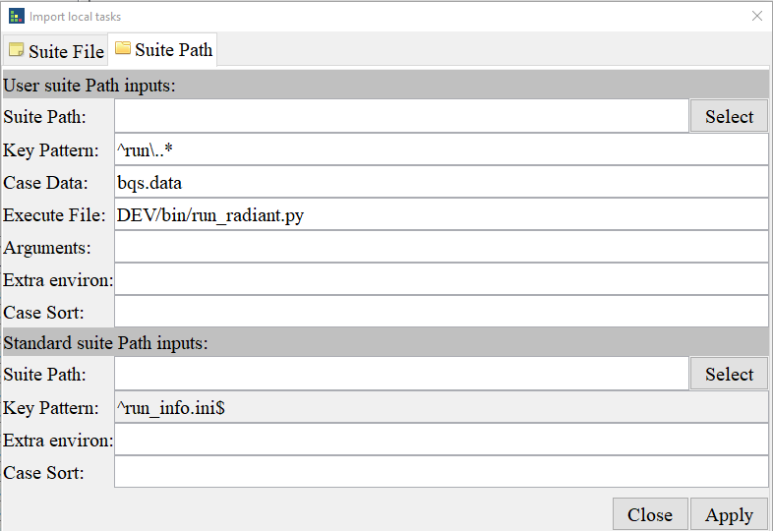
User Interface -- Case Run with Client
Launch Steps
1. Run client.exe on Windows or run client on Linux
2. Client “imports…” on top left
3. Select ‘Suite Path’ tab for suite path launch
4. Give the value of ‘Suite Path’
5. Click ‘Apply’
A path with test case inside
Note: See ‘Appendix 1’ for Client installation

Slide 17
Overview -- TMP Tool-Chain User Interface
Test Case
Test Suite
Test Project
User
objective
Core Script
TMP Client
TMP Server
Platform
support

Slide 18
Suite build & run -- Suite Build
Suite structure
Test suite is a collection of test cases and a suite description file(.xlsx) like following:
suite1/
/--case1/ -- Test case
/--case2/ -- Test case
/--case3/ -- Test case
/--case…/ -- Test case
/--suite_file.xlsx -- Suite file, with 6 elements description for all cases
/--objects.map -- (Optional) For Squish GUI run
/--suite.conf -- (Optional) For Squish GUI run
OR
suite2/
/--section1/ -- section directory
/--case1/ -- Test case
/--case2/ -- Test case
/--section2/ -- section directory
/--case1/ -- Test case
/--case2/ -- Test case
Note:
Suite2 without a suite file then all test case must have a ‘run_info.ini’ file, suite2 cannot be upload to TMP server
Demo: <Client_install_path>/doc/TMP_example/standard_suite2

Slide 19
Suite build & run -- Suite Build
Suite file
Function:
Suite file is a collection of run info for all test cases. It’s used for:
Keep all case run info(6 elements)
Construct a more complex run behavior
Upload suite info to TMP server
A suite without suite file cannot be upload to TMP(only local run support)
Layout:
workbook/
/--suite or suite_xxx -- suite sheet(s), used to put suite common info
/--case or case_xxx -- case sheet(s), used to put every detail case info
/--description -- Details about how to write and use this suite file . Ignored during Client run and upload
/--comments -- Additional comments for this test suite. Ignored during Client run and upload
Note:
Copy an existing suite file instead start from a blank xlsx file
A suite file may have multiple suite and case sheets to construct a complex run suite
Demo: <Client_install_path>/doc/TMP_example/standard_suite2/radiant_regression.xlsx

Slide 20
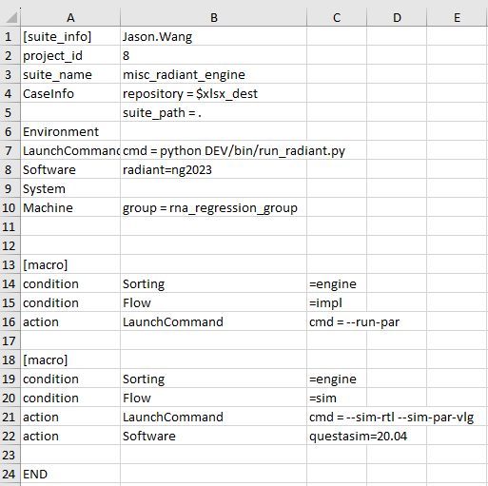
Suite build & run -- Suite Build
Suite file:Suite
Cell B1: Suite ‘Author’(Owner) will be upload to TMP
project_id: Suite belong to which project, ID can be found on Webpage
suite_name: Suite name shown on TMP webpage(After uploaded)
Suite level 6 elements: Caseinfo, Environment, Launchcommand, Software, System, Machine
Used to list suite level run info or requirements.
[Macro] macro definition, used to select case from all ‘case’ sheets and apply common setting for these case.
‘condition’: sorting rules, cases must match row14 and row15 conditions
‘action’: run actions for matched case
[Macro] another macro definition, select case and run action. Which means when a case match multiple macros, multiple case will be duplicated

Slide 21
Suite build & run -- Suite Build
Suite file:Case
Case sheet has following columns:
Order: Case id number
NoUse: ‘Yes’ to ignore this case
Title: Case title, default value is ‘design name’
Section: case section
TestScenarios: Description for test scenarios
Description: test case detail description, including presetting, expect behavior…
6 elements columns: Caseinfo, Environment, Launchcommand, Software, System, Machine. Used to list run info and requirements for this case
Note:
Priority: case level setting > suite level setting (exception: cmd = suite level setting + case level setting)
Details: <Client_install_path>/doc/TMP_example/standard_suite2/radiant_regression.xlsx :: ‘description’ sheet

Slide 22
Overview -- TMP Tool-Chain User Interface
Test Case
Test Suite
Test Project
User
objective
Core Script
TMP Client
TMP Server
Platform
support

Slide 23
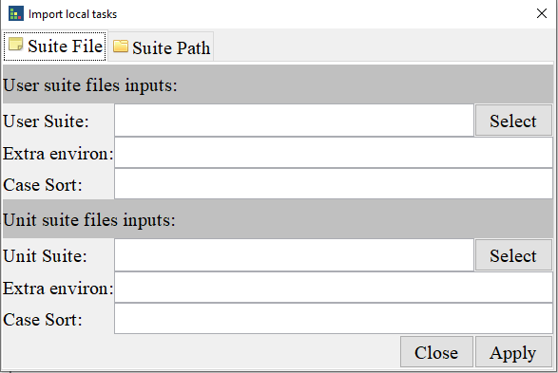
Suite build & run -- Suite Run
Client can run in console mode and GUI mode. For GUI mode, user needs to do some settings before launch client:
GUI mode
CMD mode
Open TMP client
Click: File -> Imports
Select suite file by ‘Select’ button
Click ‘Apply’ to start test
Test Environment:
set EXTERNAL_RADIANT_PATH=C:\lscc\radiant\ng2024.2
Launch Environment:
unset PYTHONHOME
set PATH=x:/xx/TMP_Client/bin:${PATH}
Launch Commands:
clientc.exe -c -l -f x:/xx/eit_demo/suite_file.xlsx
More options:
-k key pattern for test case identify, default value is ‘run\..*’
-S Task case sorting, format option1=value1;option2=value1,value2, demo: level=1
-K Keep the original directory tree structure
-t <number>, threads to run case parallelly
-w ‘work space’, where to run your cases, it’s better to assign a place with 50G+ space
Suite file path
Note:
Client check suite file 6 elements to know match requirement or not and run case
See ‘Appendix 1’ for detail Client install, setting and usage

Slide 24
Overview -- TMP Tool-Chain User Interface
Test Case
Test Suite
Test Project
User
objective
Core Script
TMP Client
TMP Server
Platform
support

Slide 25
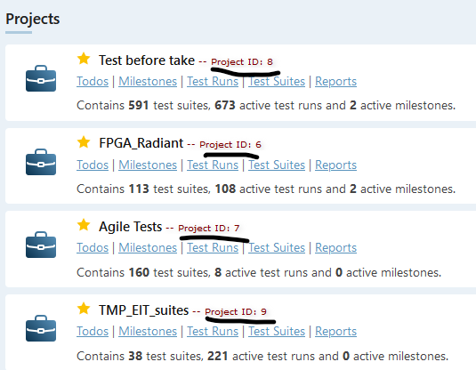
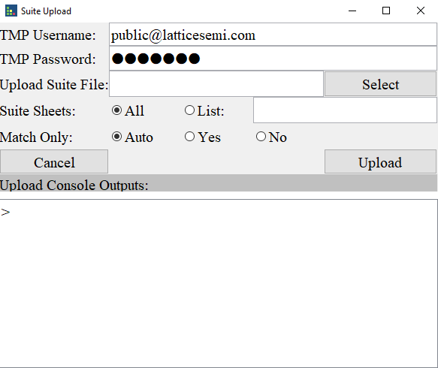
Project build & run -- Project build
Upload Suite
Confirm Suite file
‘project_id’ align with project number in TMP webpage
‘suite_name’ approved by manager (Except ‘Test before take’ project)
With Client to upload test suite
click Client menu: Tools → Upload…
Input account and password of TMP(default value only allow you upload suite to ‘Test before take’ project)
Click ‘Select’ button to select suite file for upload
‘Suite Sheets’: allow you upload all suites or specific suites sheet(For multiple suite sheet file, separate by ‘,’)
‘Match only’: Auto mean:
Suite file with one suite sheet: all case will be uploaded even a case not matched with macro sorting rules
Suite file with multiple suite sheet: only matched case(with macro) will be upload
Note:
You are only allowed to upload test suite to project 8, for other projects please contact your manager or TMP admin (Shawn Yan <Shawn.Yan@latticesemi.com>)
Notes:
Prepare your test suite file
Open TMP client
Upload suite to TMP webpage

Slide 26
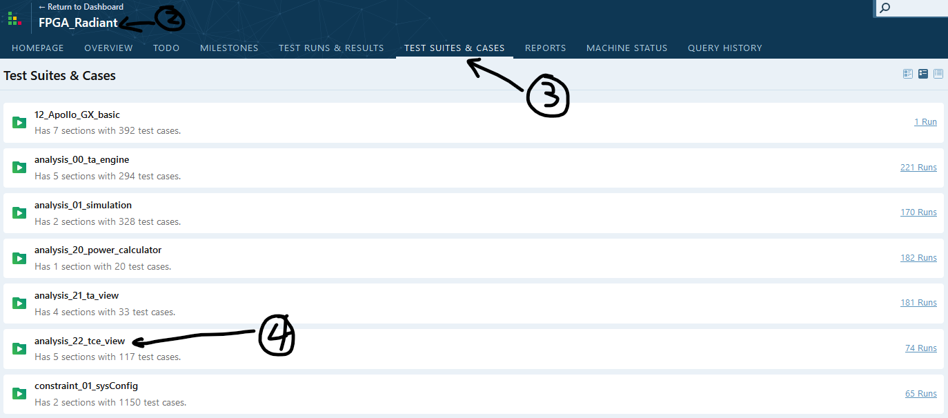
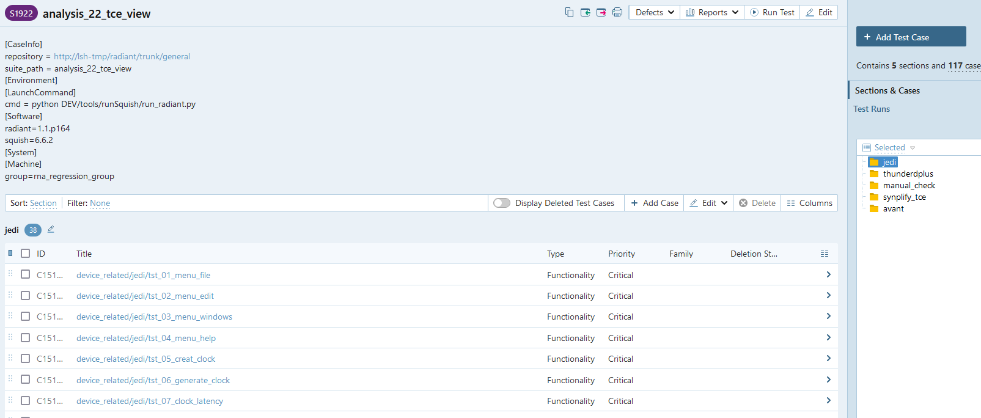
Project build & run -- Project build
Uploaded Suites
Uploaded suite confirm:
Go to TMP dashboard: http://lsh-tmp/testrail/index.php?/dashboard
Click your uploaded project
Click ‘TEST SUITES & CASES’
Click your uploaded suite
Confirm:
Suite description
Sections
Cases
Suite description
Suite sections
Note:
Suite file(xlsx) has 3 levels: suite, macro, case
TMP webpage only has 2 levels: suite and case
xlsx suite info shown on webpage suite
xlsx macro + case info shown on webpage case
Cases
Notes:
Prepare your test suite file
Open TMP client
Upload suite to TMP webpage

Slide 27
Overview -- TMP Tool-Chain User Interface
Test Case
Test Suite
Test Project
User
objective
Core Script
TMP Client
TMP Server
Platform
support

Slide 28
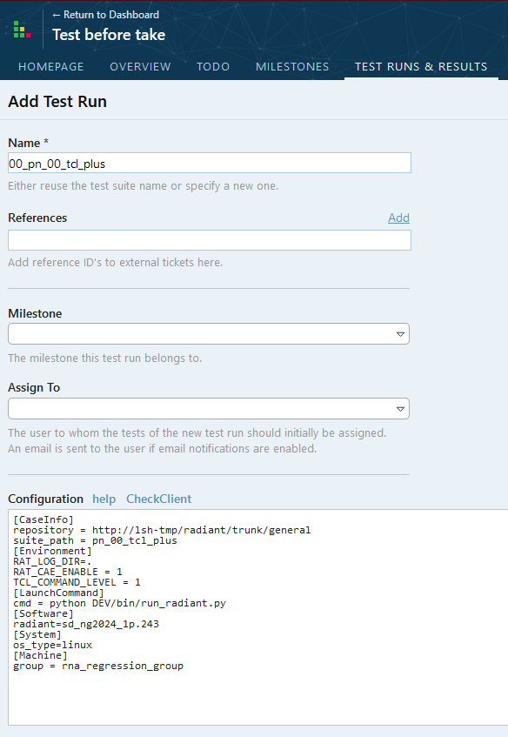
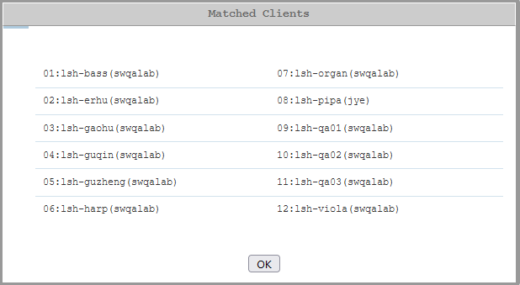
Project build & run -- Project Run
Run Suite
Start a Test run:
Method1: On ‘TEST RUNS & RESULTS’ tab:
Click ‘+ Add Test Run’ in left panel
Select test suite
Method2: On ‘TEST SUITES & CASES’ tab:
Select test suite
Click ‘Run Test’
Configure a Test run:
Update run name
Update milestone if have
Update run ‘Configuration’ (based on run requirement)
Confirm background Clients can take this task by click ‘CheckClient’
Test case select (All or specific case)
Click ‘Add Test Run’
Note:
TMP webpage will search all matched Clients based on:[Software], [System], [Machine].

Slide 29
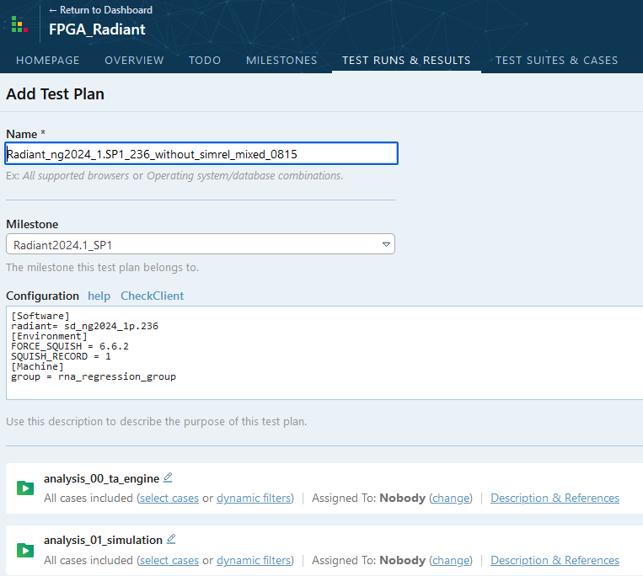
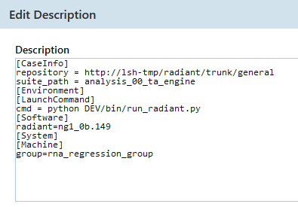
Project build & run -- Project Run
Run Plan(Project)
Start a Project run:
Method1: ‘TEST RUNS & RESULTS’ tab:
Click ‘+ Add Test Plan’ in left panel
Add test suite
Method2: In an existing run plan: i.e. R279937
Click ‘Rerun’
Select test case for rerun
Configure a Test Plan:
Update run name
Update milestone if have
Update Plan level ‘Configuration’: Software, Environment, Machine
Confirm background Clients can take this task by click ‘CheckClient’
Test suite select/add/remove
Update Suite level ‘Description & References’
Click ‘Add Test Run’
Note:
Plan level requirements override Suite level requirements

Slide 30
Agenda
Overview
Case build & run
Suite build & run
Project build & run
Run Control and Results check
Q&A

Slide 31

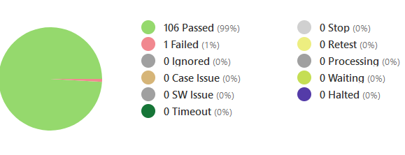
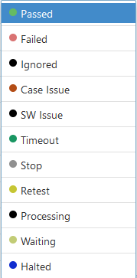
Run Control and Results check -- Webpage
Run Status/Control
When a ‘Test Run/Plan’ launched:
1.TMP will show run progress on top and we can Control it by:
Stop -- Stop the whole run, all test case will go to ‘Halted’
Pause -- Stop ‘Waiting’ case only, ‘Waiting case go to ‘Halted’
Play -- Start ‘Halted’ case again
2. TMP will show all test case status:
Failed -- Test status, Case run finished and check failed
Ignored -- Test status, Case ignored(invalid case)
Case Issue -- Test status, Case missing files or has a wrong format
SW Issue -- Test status, Case run finished, check failed but linked a valid CR
Timeout -- Test status, timeout(default timeout value 7200s)
Processing -- Test status, Case running in remote Client
Waiting -- Test status, Case test not start(didn’t move to remote Client)
Halted -- Test status, Case stopped on remote Client(report by Client)
Stop -- Action, TMP will try to Stop this case(‘Processing’ on remote Client)
Retest -- Action, TMP will retest this case

Slide 32
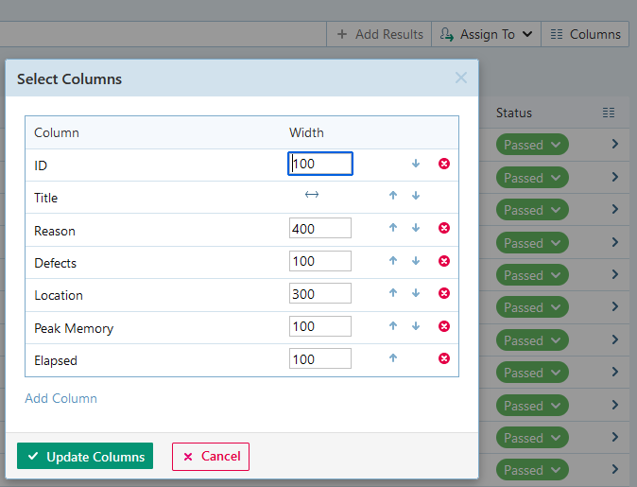
Run Control and Results check -- Webpage
Result Check
Case run result columns configure:
Click ‘Columns’ in a test run/plan page add following:
Reason: Why this case failed. Error message or failed check method(FC) will be reported.
Defects: Linked Jira CR will be reported/shown
Location: Case run location. <Machine name>:<Run Path>
Peak Memory: Peak Memory used for this case run
Elapsed: Case run time in seconds
Level 1 result check:
In suite run overview page you can see a test case run general info like following:
Reason -- Failed due to method ‘check_sim_par’ check
Location -- Run on ‘lsh-qa01’ a Linux machine
Peak Memory– 1.29G memory used
Elapsed -- run time: 6m 14s
Note:
On this level we used to get an overall sense, issue can be a specific Machine or System

Slide 33
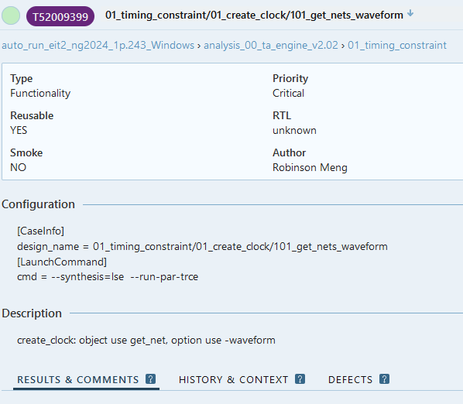
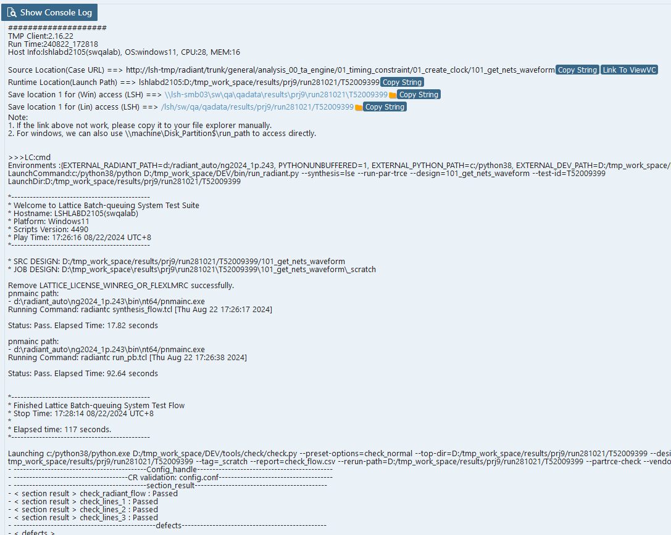
Run Control and Results check -- Webpage
Result Check
Level 2 result check:
After you click a test case in suite run page, we can go into a detail test report page, we will have:
Test case information: Type, Priority, Author…
Configuration: case level run info
Description: case level detail description
‘Result & Comments’: test results and comments
‘History & Context’: history test results
Click ‘Show Console Log’, we will have:
Run Client version
Host machine status
Case Result unified ‘Save location’
Console logs step by step
Check file and filed check method
Demo: T52011512
Note:
On this level we used to get case level issues: run issue, check issue…

Slide 34
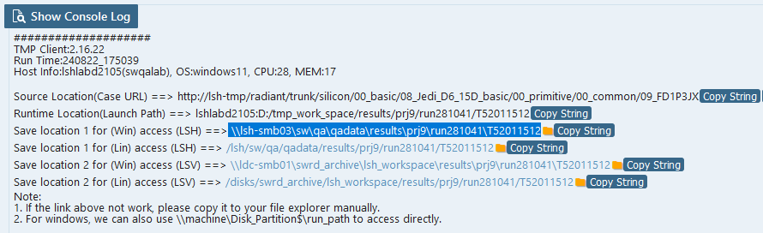
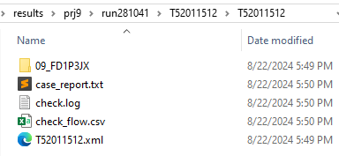
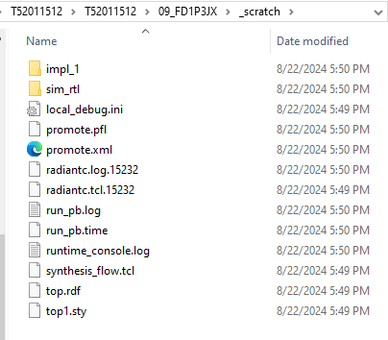
Run Control and Results check -- Webpage
Result Check
Level 3 result check:
Go to ‘Save location’ shown in ‘Show Console Log’:
Select a path based on your system status
Go into the path
All details run log files here:
check.log -- Detail check report
case_report.txt – case run console log
_scratch – Design run directory
run_pb.log – Radiant console outputs
run_pb.time – Run commands
Impl_1 – Engine reports: .mrp, .par
Demo: T52011512
Note:
On this level we used to get case detail run issue or SW issues.

Slide 35
THANKS
Q&A

Slide 36

Appendix 0 –Platform build for two sites(Suggestion)
LSH
LPG
TMP webpage
Case Repository
Case Repository
Only task info
(6 elements) transferred!
Job Server
Real design transferred
Locally
Client
Client
Client
Client
Client
Client
Real results transferred
Locally
Results
Storage
Results
Storage
Notes:
Case repository can be: SVN, FTP, Remote central storage, local disk

Slide 37
Appendix 1 – Client Environment setup
Python Setup:
Source:
\\lsh-smb04\sw\qa\qa_store\TMP_tools\depend_software\python_and_packages (LSH win access)
/disks/swrd_archive/sqa_lsv/test_management_platform/depend_software/python_and_packages (LSV lin access)
Install Python:
Double click: python-3.8.7-amd64.exe (Windows) or unzip Python-3.8.7.tar.xz(Linux)
Put Python install path into environment ‘PATH’ variable
Install Python Packages:
cd ‘offline’ folder
Run following commands in console(dos):
python -m pip install --no-index --find-links . psutil==5.8.0
python -m pip install --no-index --find-links . JIRA==2.0.0
python -m pip install --no-index --find-links . openpyxl==3.0.7
python -m pip install --no-index --find-links . pymysql==1.0.2
Verify:
Run following commands in console(dos):
python -- Python should be run with a correct version
import psutil -- Python package imported, no crash
import jira -- Python package imported, no crash
import openpyxl -- Python package imported, no crash
import pymysql -- Python package imported, no crash

Slide 38
Appendix 1 – Client Environment setup
SVN Setup:
Source:
/disks/swrd_archive/sqa_lsv/test_management_platform/depend_software/Setup-Subversion-1.6.6.msi
Install SVN:
Double click: Setup-Subversion-1.6.6.msi
Put SVN install path into environment ‘PATH’ variable
Verify:
Run following commands in console (dos):
svn --version -- SVN should report correct version
Client Setup:
Source:
\\lsh-smb04\sw\qa\qa_store\TMP_tools\client_software (LSH win access)
/disks/swrd_archive/sqa_lsv/test_management_platform/client_build (LSV lin access)
Install Client With Wizard:
Double click: tmp_client_<version>_installer_bin_windows.exe
Select ‘Installation Folder’
Put Client bin path(<install_path>/bin) into environment ‘PATH’ variable (Optional)
Verify:
Run following commands in console (dos):
Clientc.exe -h -- Client will display current version and simple usage

Slide 39
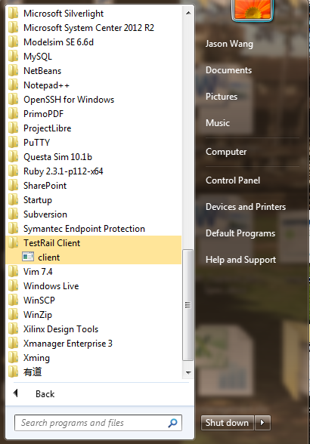
Appendix 1 – Client Environment setup
Launch Client:
Launch from Start Menu (Windows):
On Windows platform we can launch TMP client from start menu.
Please click “Start Menu” → “All Programs” → “TestRail Client” → “client”
Launch from command line(dos):
Please use following command lines to launch client:
<client_install_path>/bin/clientc.exe –c (console mode)
<client_install_path>/bin/client.exe (GUI mode)

Slide 40
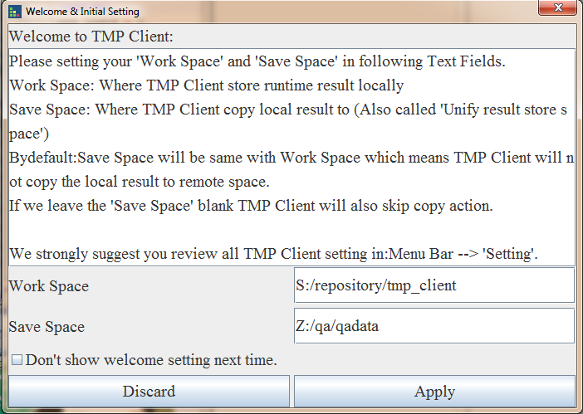
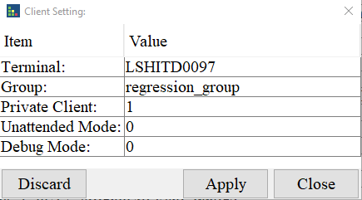
Appendix 1 – Client Environment setup
GUI Initial Setting 1:
Welcome setting:
You will be prompted a welcome setting dialog like following. You can specify ‘Work Space’, ‘Save Space’ and click ‘Apply’ button to finish the setting.
‘Work Space’ : location/space for test case run
‘Save Space’ : client make a copy of test case here(Work with TMP platform, leave it open for personal use)
See ‘Appendix 3 – Case work flow’ for more details.
Client setting:
Click “Setting” → “Client…”:
Terminal -- Client name
Group -- Setting the client group name
Private -- value can be “0” or “1”, the default name is “1”
“0”: public client will run assigned and matched task.
“1”: private client will run assigned task only.
Unattended -- value can be “0” or “1”, the default name is “1”
“0”: Attended Mode. SW do some special work (i.e. SW update) under user’s operation.
“1”: Unattended Mode. SW do some special work (i.e. SW update) automatically.

Slide 41
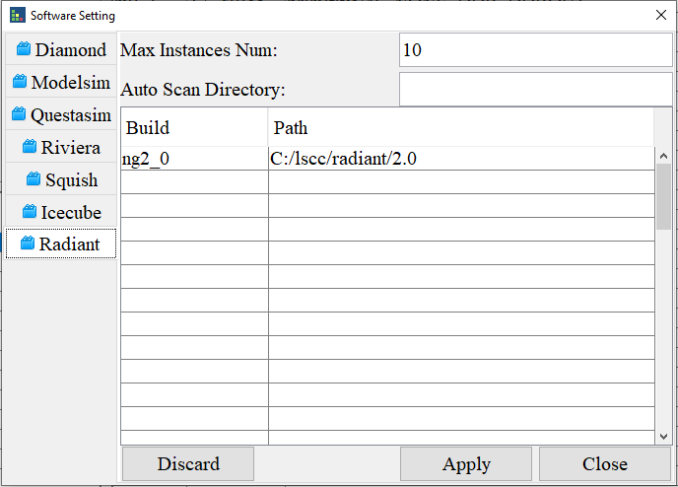
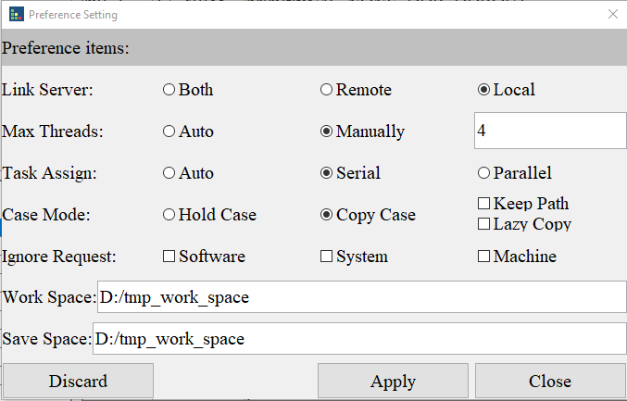
Appendix 1 – Client Environment setup
GUI Initial Setting 2:
Software setting:
Click “Setting” → “Software…”. Set current host machine available Software and Maximum instances can be launched for this Software.
‘Build <--> Path’ : Build name and real installation path
‘Max Instances Num’ : Maximum instances can be launched for this Software
Preference setting:
Link_mode: value can be “both”, “remote” and “local”. Client linked server select.
Max_threads: Maximum threads (test case) can be launched.
Thread_mode: value can be “auto” and “manual”
Task_mode: auto, serial and parallel.
Auto: client will take top priority level tasks and run parallel these tasks.
Serial: client will run task one by one according the task priority
Parallel: client will run tasks in parallel mode
Work_space: client work space, client will download and run case in this folder.
Save_space: client result save space. If doesn’t present client will skip copy case runtime results.

Slide 42
Appendix 1 – Client Environment setup
Initial Setting for Console mode(Optional):
Actually, GUI dialogs are wrappers for the Client core engine, All the GUI settings were saved to following file, so for Console mode we can update this file directly：
Config file: <user_home_path>/client_conf/<machine_name>.ini
This xxx.ini file contains two kinds of sections:
Section without “tmp_” : Client software setting section
Section with “tmp_” : Client setting section.
You can update the software, client and preference setting in this file directly.

Slide 43
Appendix 1 – Client Environment setup
Initial Setting for Personal usage(Suggestion):
GUI Software setting (or <software name> in xxx.ini file):
NA
GUI Client setting (or tmp_machine in xxx.ini file):
group = regression_group
private = 1 -- Private mode, remote task will not use this client
GUI Preference setting (or tmp_preference in xxx.ini file):
link_mode = local -- Do not link to remote server
max_threads = 3 -- Client can launch 3 case parallelly
work_space = D:/tmp_work -- Your prefer path for case run
python = C:/Python38/python.exe -- Python bin path
*: Please keep other setting as default.

Slide 44
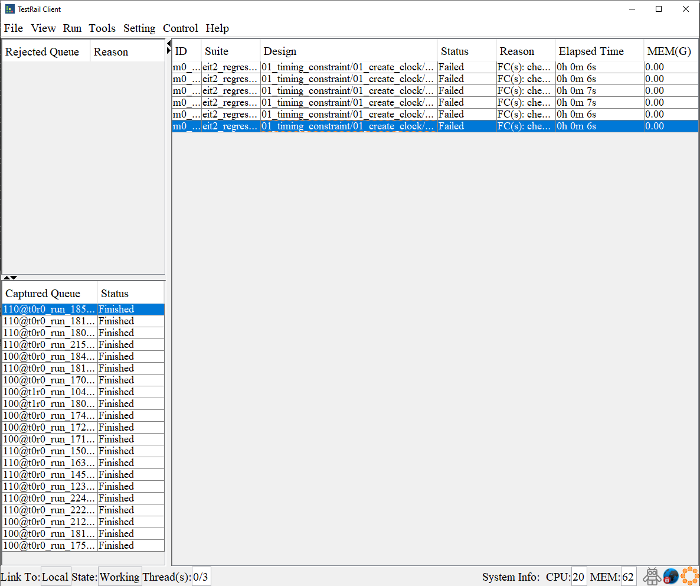
Appendix 2 – Client GUI Usage
Client Overview
TMP Client(Client) can be a tool of whole TMP tool-chain, it can also work with CoreScript on your local machine standalone.
Client run in standalone/local mode still follow ‘Request’ and ‘Available’ match mode as follows:
[Software]: must match
[System]: ignored
[Machine]:ignored
‘Request’: run_info.ini file, suite file (with 6 elements)
‘Available’: Client software setting, System, Machine…
Client local mode can:
Run your new build test case(with run_info.ini inside)
Run your new build test suite(without a suite file)
Run your new build test suite(with a suite file)
Run/debug support for test suite local run(retest, stop, evaluate)
Upload your suite file to TMP

Slide 45
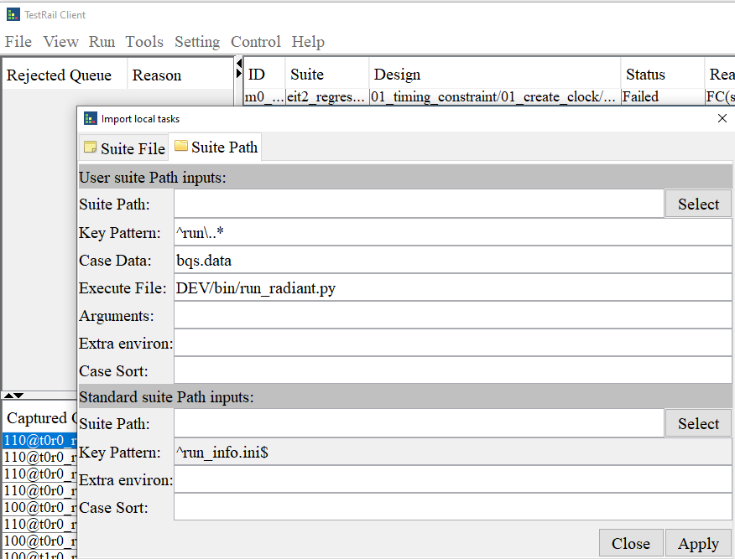
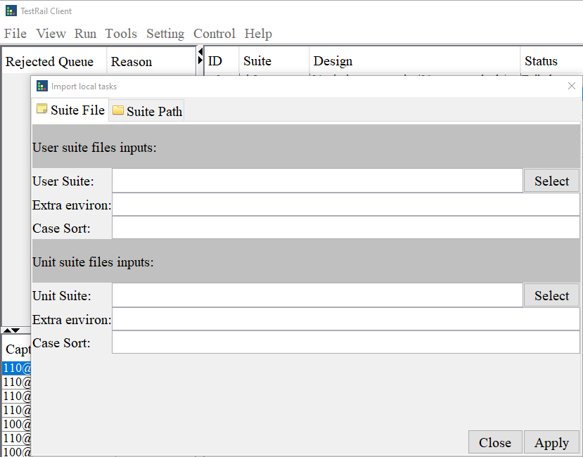
Appendix 2 – Client GUI Usage
Run Case/Suite
Run a case or a suite without suite file:
Confirm all test cases have run_info.ini inside(with 6 elements)
Click ‘File’ → ‘Imports…’ → ‘Suite Path’
Click ‘Select’ in ‘Standard suite Path inputs:’ section
Select the Path/suite path contain all test cases
Add ‘EXTERNAL_RADIANT_PATH=<Radiant install path>’ in ‘Extra environ:’ (If run_info.ini has ‘radiant=xxx’ set already, skip this setting)
Click ‘Apply’
Run a case or a suite with suite file:
Confirm test suite file(xlsx) existing
Click ‘File’ → ‘Imports…’ → ‘Suite File’
Click ‘Select’ in ‘User suite files inputs’ section
Add ‘EXTERNAL_RADIANT_PATH=<Radiant install path>’ in ‘Extra environ:’ (If suite file has ‘radiant=xxx’ set already, skip this setting)
Click ‘Apply’

Slide 46
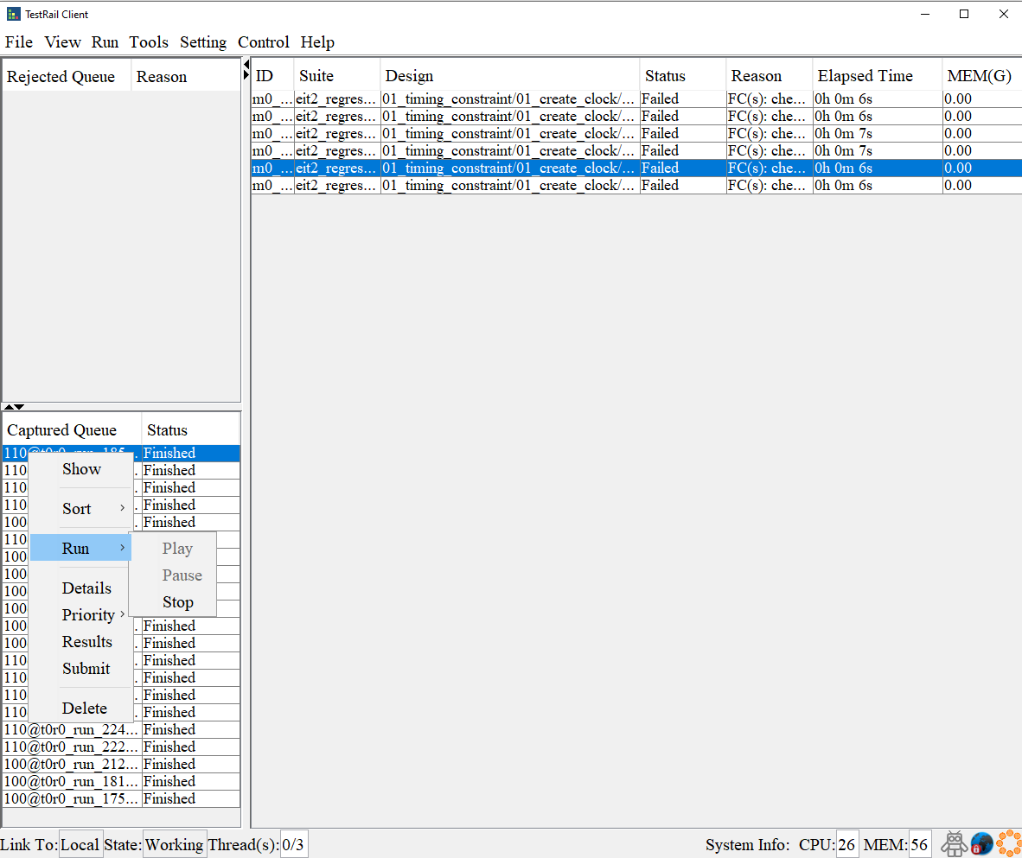
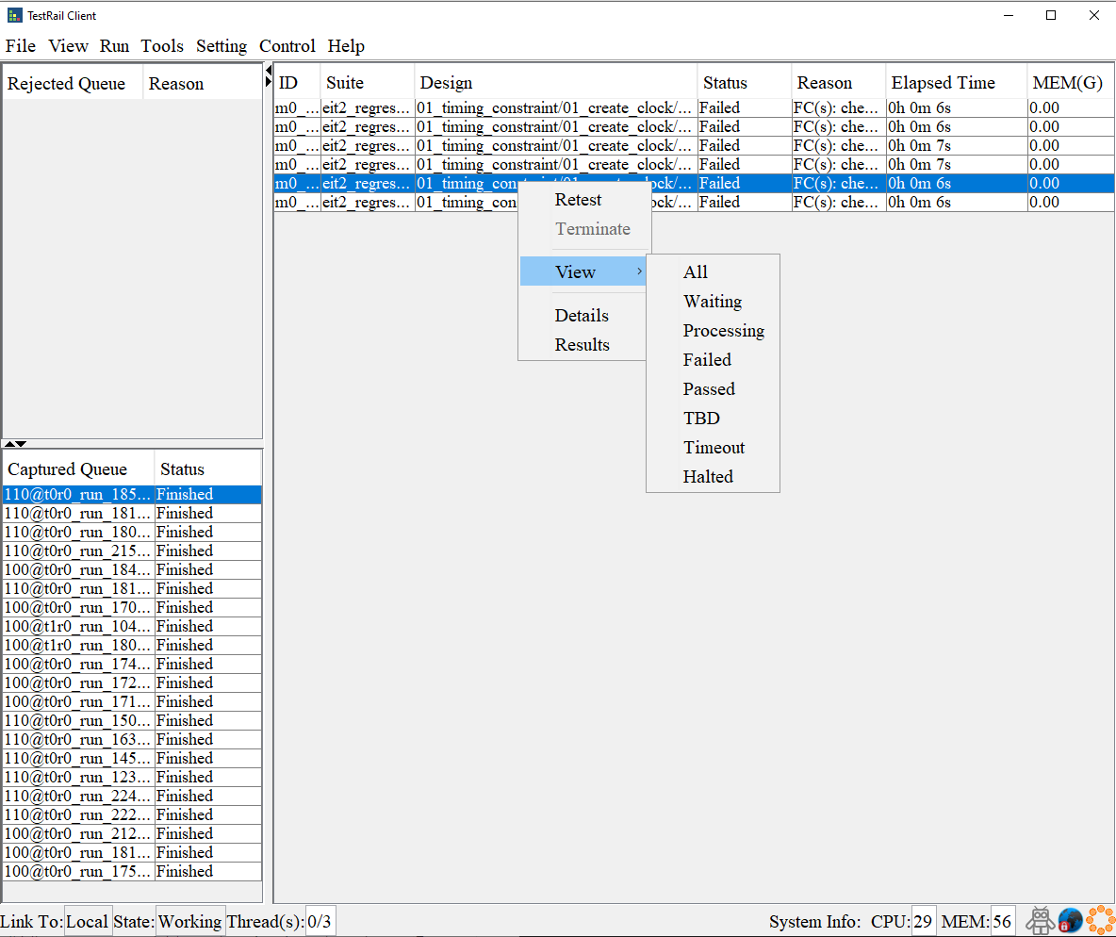
Appendix 2 – Client GUI Usage
Run Control
Suite level control:
Click/Select a test run in ‘Captured Queue’, click ‘Run’ on menu:
Play -- Paused: continue run, Stopped: run from beginning
Pause -- Stop more case running
Stop -- Stop a Running suite(queue)
Retest: All, Failed, timeout… -- Retest selected cases
Case level control:
Select one or multiple case by mouse
Right click
Retest -- Retest this case
Terminate -- Stop this case

Slide 47
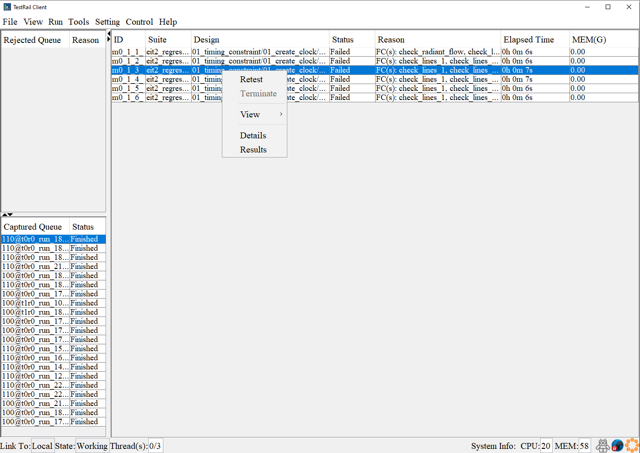
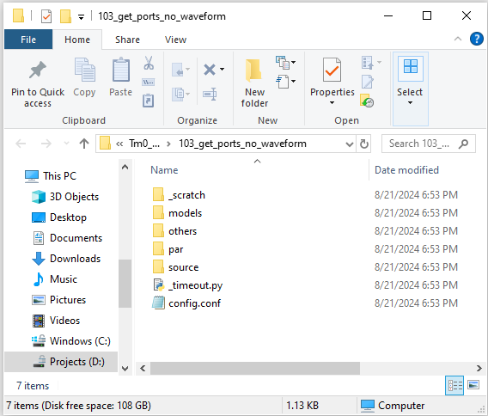
Appendix 2 – Client GUI Usage
Result Check
Level1 Check:
Double click task queue, you will see all test case in this task.
Reason column show:
Error message
Failed check function
Elapsed Time show test run time, refresh every 10s
MEM show test case current memory usage, refresh every 10s
Level2 Check:
Select a case and right click
Click ‘Results’, Client will open Test case run directory:
check.log -- Detail check report
case_report.txt – case run console log
_scratch – Design run directory
run_pb.log – Radiant console outputs
run_pb.time – Run commands
Impl_1 – Engine reports: .mrp, .par

Slide 48
Appendix 3 – Client Case work flow
Client will read the case info from Suite file and download the case to ‘work Space’ and run it then copy the run result to ‘Save Space’ if needed.
-w to set client work space
-s to client save space, if don’t need give the same value as -w
* Client will remember your setting, only for first launch.
Suite File/Path
Optional
Depot
Work Space
Save Space
SVN/FTP/Storage…

Slide 49
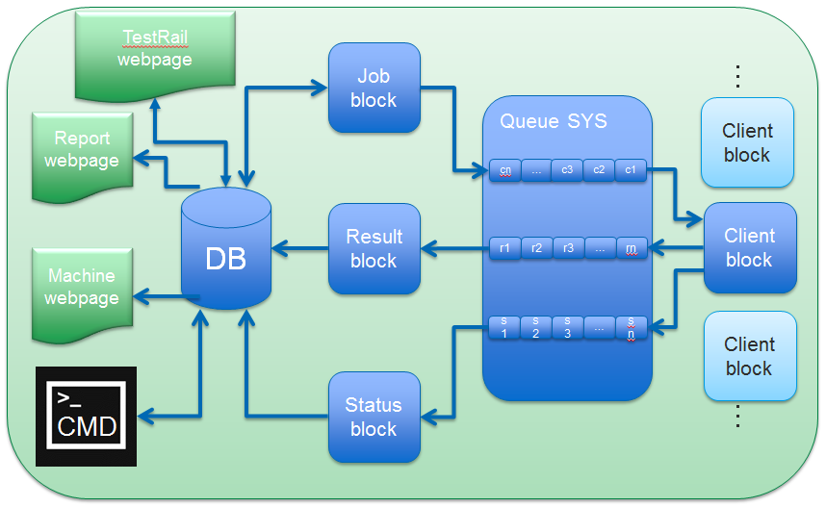
Appendix 4 -- TMP Architecture
Logical View

